Slide 1


ECEN 404
Creating STEM Contents: Solar Power with a Tracking System
Status Update #2
Leo Predanic
George Thuita
Brandon Cenci
Sponsor: Dr. Won Jang
TA: Souryendu Das

Slide 2

Executive Summary
Problem statement:
To create the future of tomorrow, we must invest today - by getting students interested in STEM early
Our Solution:
Excite K-12 students by creating a portable solar system for demonstration purposes
Contain digestible figures & animations to describe/track system

Slide 3
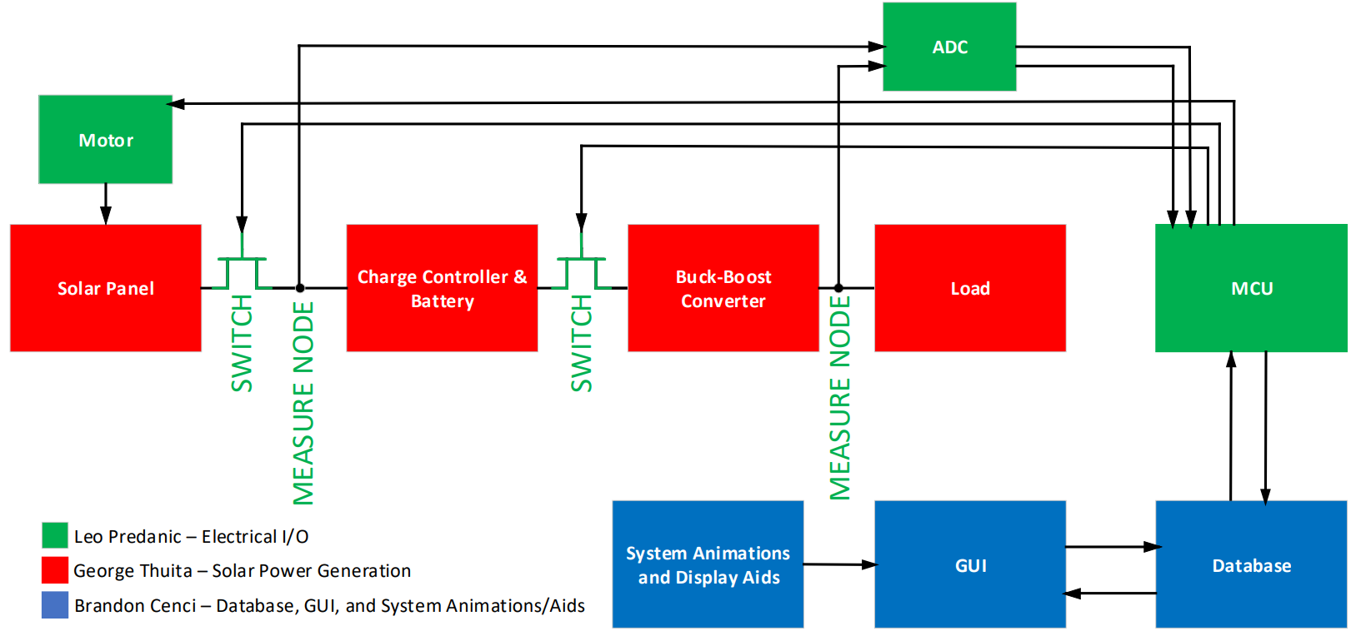
System Flow & Overview

Slide 4
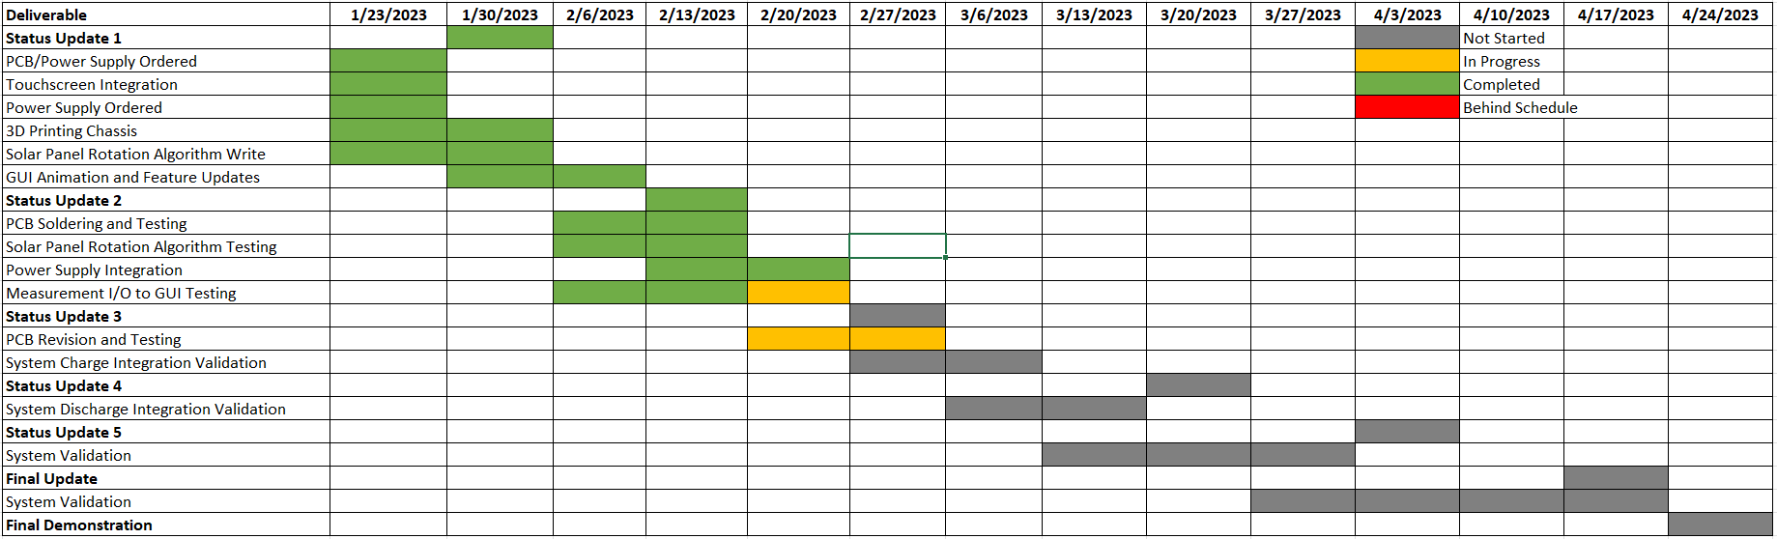
Execution

Slide 5
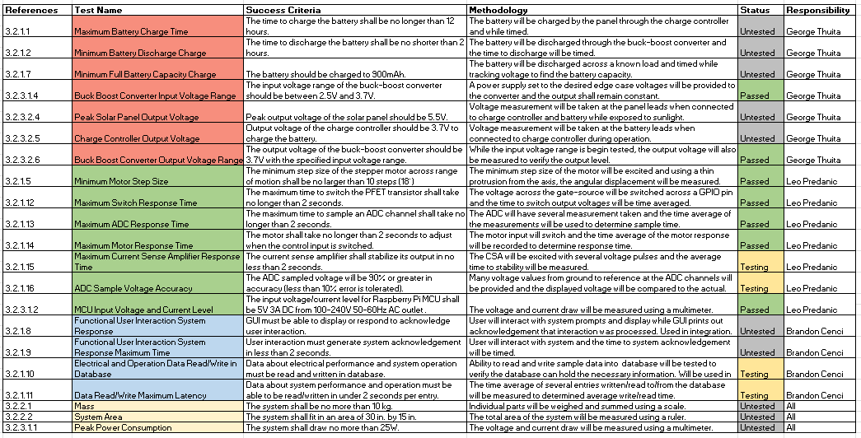
Validation

Slide 6
Solar Power Generation-Electrical I/O George Thuita/Leo Predanic
Accomplishments since last presentation 30 hrs | Ongoing progress/problems and plans until next presentation
-EPS registered -Supply soldered and tested -PCB 95% soldered -PCB 85% tested -PCB tested with RPi and verified with testbench equipment -Buck/Boost Converter works, no oscillation issue -ADC voltage measurement works -Load can be powered | -Issue with CSA nets, supply and output nets are reversed, modifications being made -Testing ADC and CSA simultaneous measurement (power) -Begin integration with GUI subsystem

Slide 7
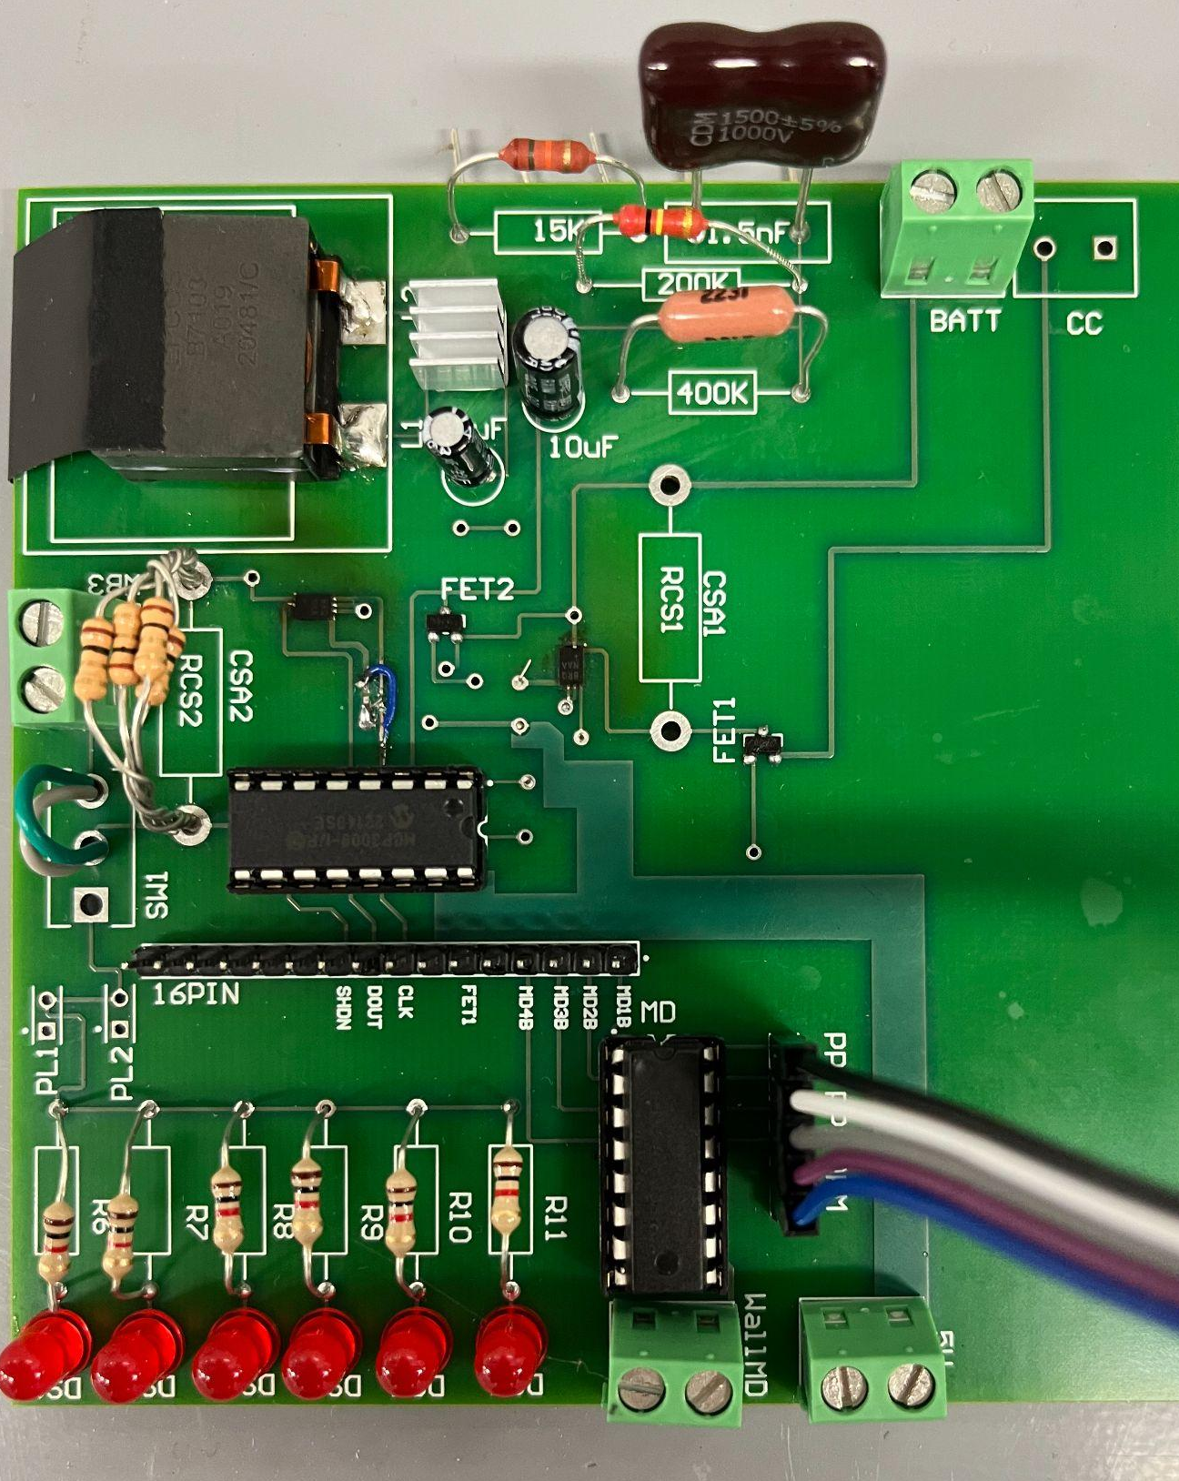
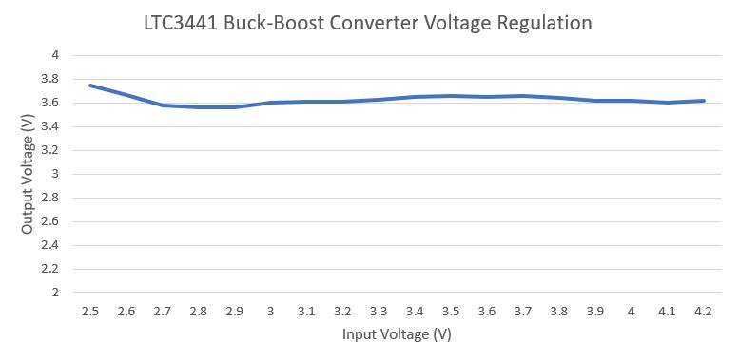
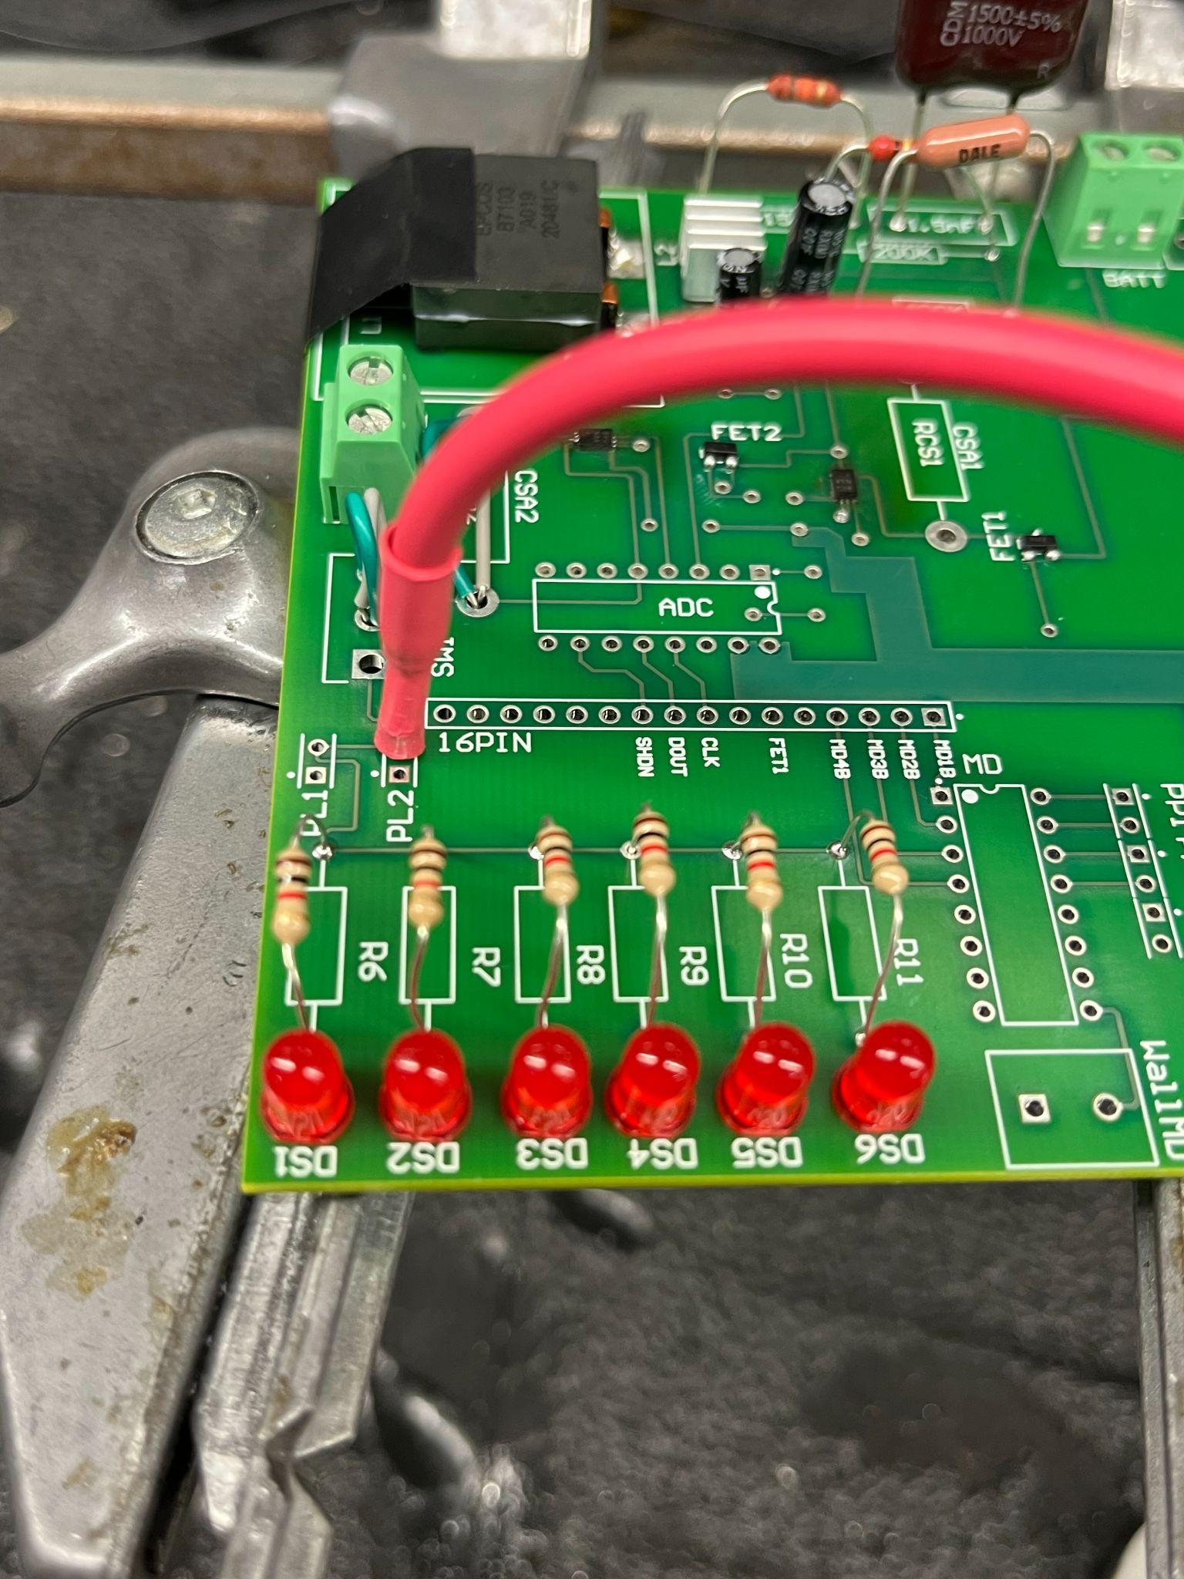
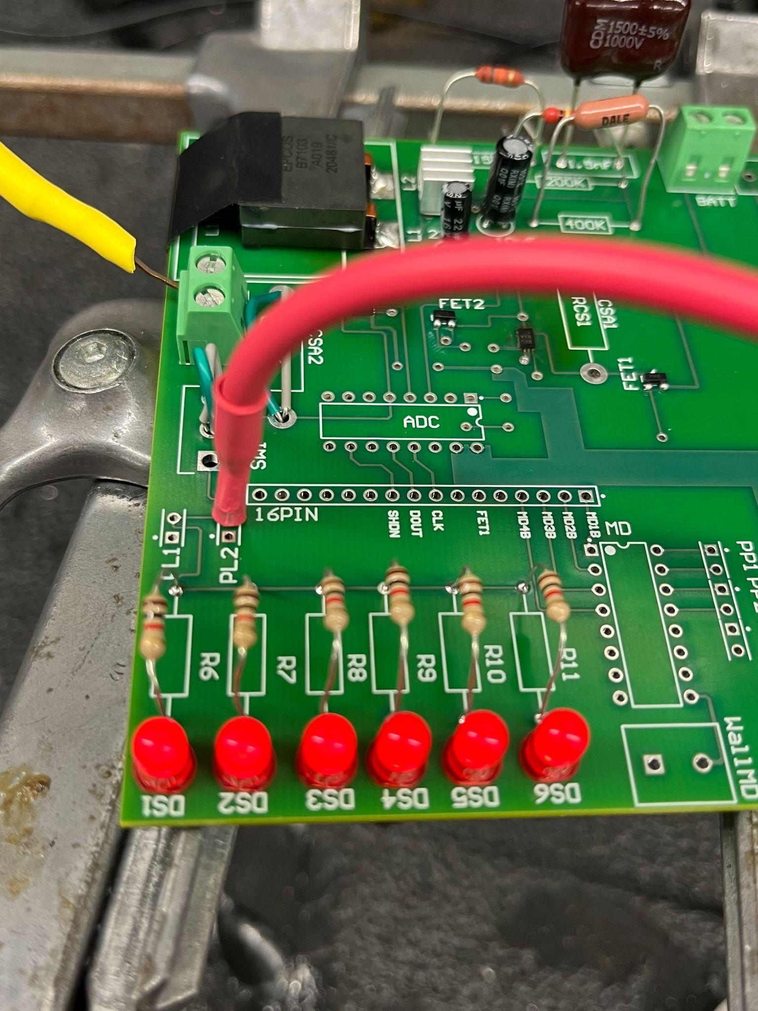
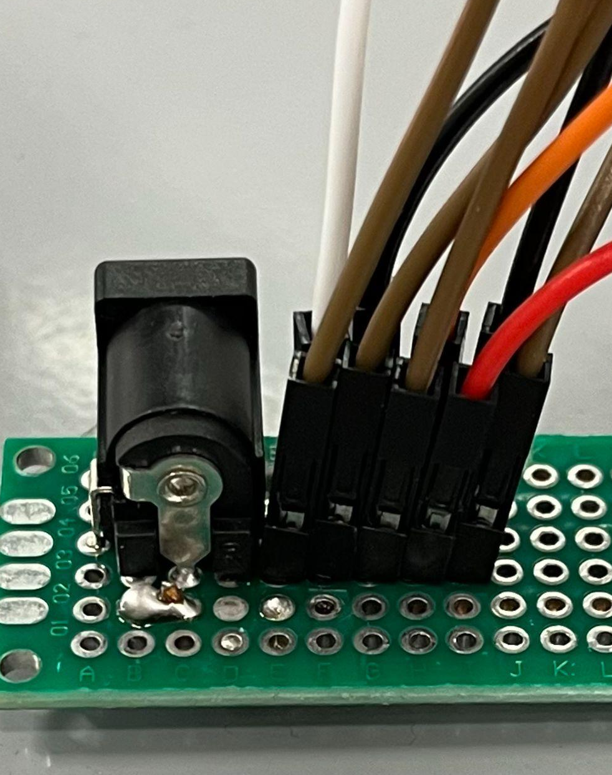
Solar Power Generation-Electrical I/O (2) George Thuita/Leo Predanic
PCB
Supply
LEDs Off
LEDs On

Slide 8
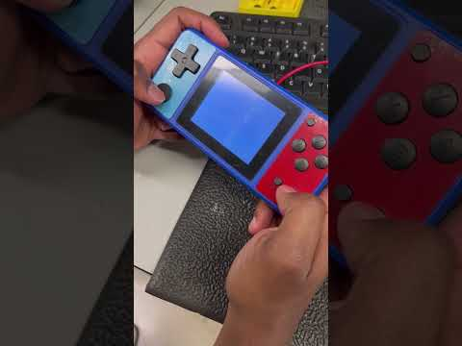
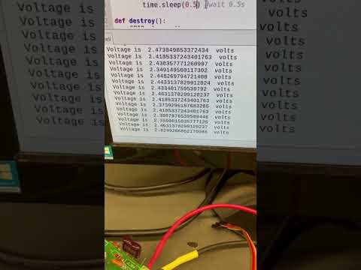
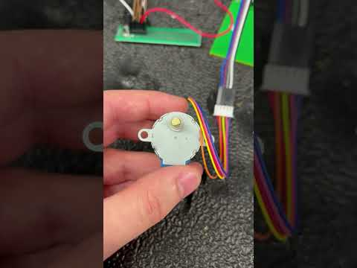
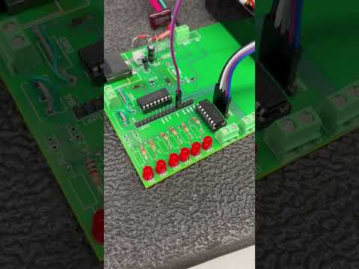
Solar Power Generation-Electrical I/O (3) George Thuita/Leo Predanic
Powering Load
ADC Voltage Sampling
Motor Operating
FET Switching LEDs

Slide 9
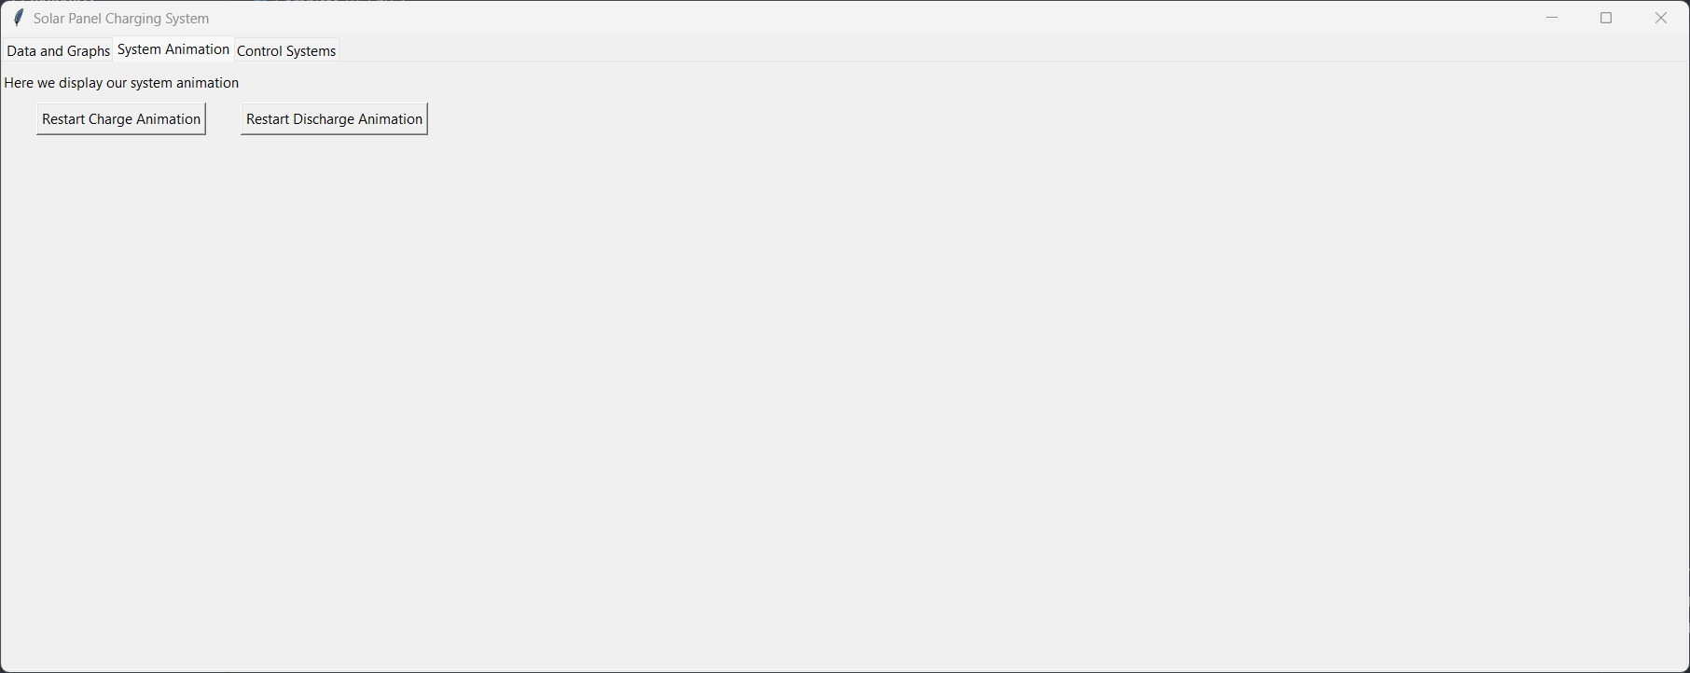
GUI and Database-Electrical I/O Brandon Cenci/Leo Predanic
Accomplishments since last presentation 20 hrs | Ongoing progress/problems and plans until next presentation
-Finished minor GUI features/animations -Writing/testing code to test ADC measurement display to GUI -Added functional real-time measurement feature -Added immediate measurement change graph | -Finish measurement display to GUI -Begin integrating with PCB to test GUI control signals -Additional GUI formatting/cleaning
New
Old

Slide 10
GUI and Database-Electrical I/O (2) Brandon Cenci/Leo Predanic
Time [s]

Slide 11
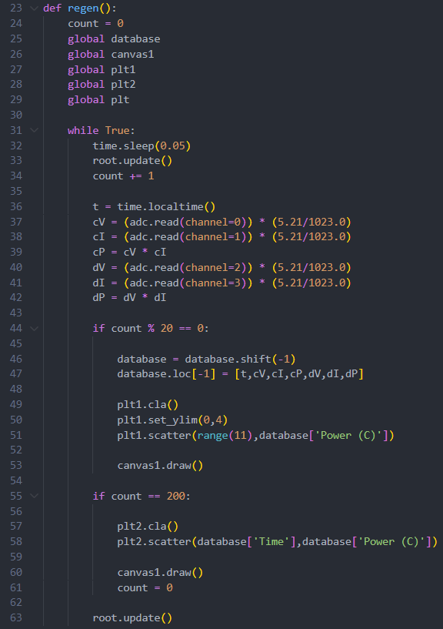
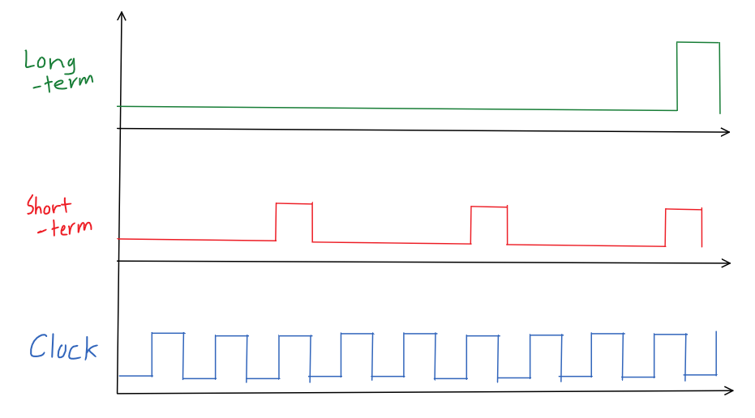
GUI and Database-Electrical I/O (3) Brandon Cenci/Leo Predanic

Slide 12
Thank You!
Questions?

